Slide 1

Salary Prediction Using Linear Regression
Group 11
Amogh Chavan :- Executive Lead
Puthineedi Vyshnavi :- Documentation Lead
Kshitiz Kumar :- Video Lead
Livteshwar Singh Sandhu :- PPT Lead
Git Hub Repo Link:-
https://github.com/2026esb1489-glitch/employee-salary-compensation-prediction

Slide 2
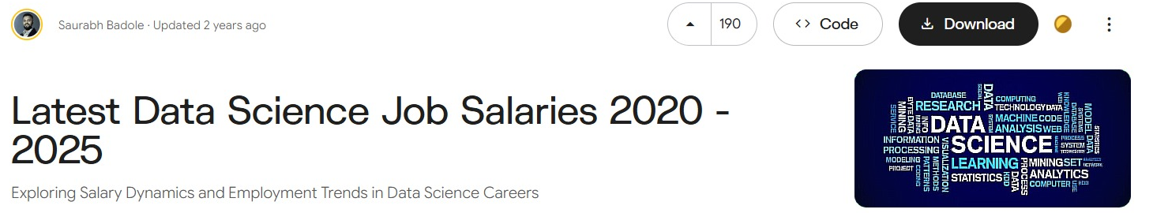
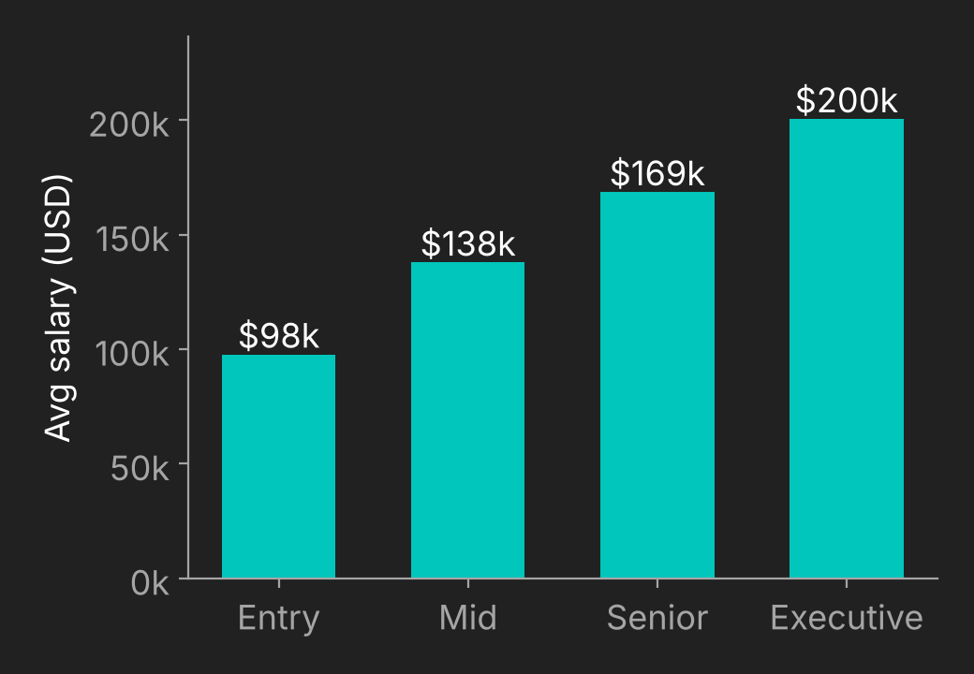
Problem and Data
Problem: Predict an employee's annual salary (USD) with multiple linear regression.
Why: Help organisations check and improve internal compensation equity.
Dataset: "Latest Data Science Job Salaries 2020–2025" (Kaggle, by Saurabh Badole).
Size: 93,597 rows × 11 columns; 46,637 rows remain after removing duplicates.
Target: salary_in_usd
Features (7): experience level, company size, employment type, job title, company location, work year, remote ratio.
Kaggle Dataset Link: https://www.kaggle.com/datasets/saurabhbadole/latest-data-science-job-salaries-2024/code
Average salary rises with experience level
Notes:
The dataset has no education or department columns, so the model uses the experience, job and company features that are available. Duplicates were removed before modelling (93,597 → 46,637 rows).

Slide 3





Approach
1 Data
Kaggle CSV with 93,597 rows and 11 columns
2 Clean
Drop duplicates, leaving 46,637 rows. Target is salary_in_usd
3 Preprocess
Fill missing values, encode the categories, scale the numbers
4 Model
Linear Regression, trained on 80% and tested on 20%
5 Output
Predicted salary, checked with R², MAE and MSE
Ordinal encoding: experience_level (EN < MI < SE < EX) and company_size (S < M < L)
One-hot encoding: employment_type, job_title and company_location, up to 10 categories each
Scaling: work_year and remote_ratio, using StandardScaler
Libraries: pandas, NumPy, scikit-learn, Matplotlib
Notes:
Pipeline: data, clean, preprocess, model, output. Preprocessing and model sit in one scikit-learn Pipeline, so train and test data get exactly the same steps.

Slide 4
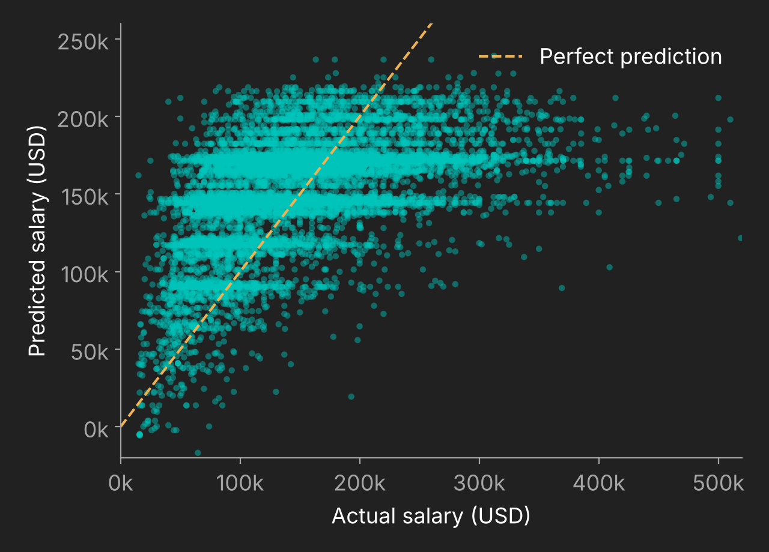
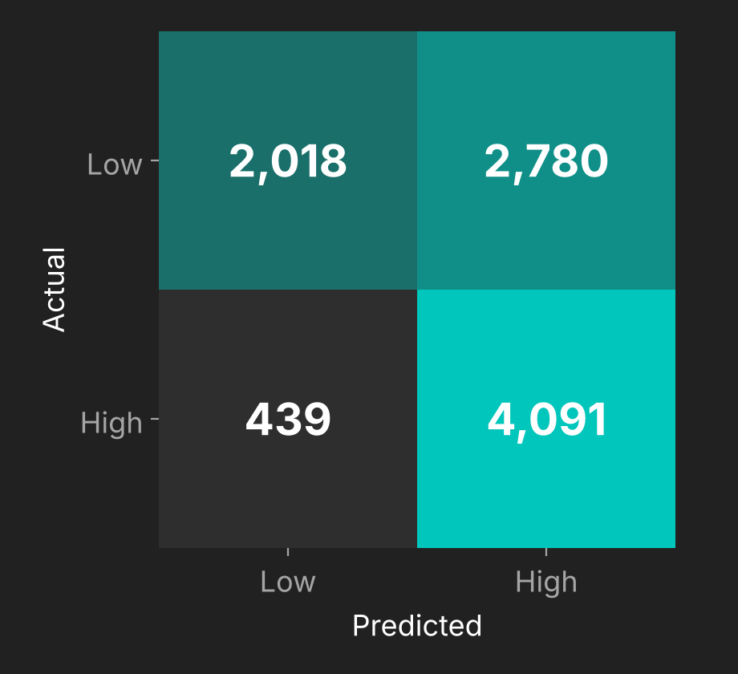
Results
0.23
R² score
$49.5K
MAE (average error)
$67.3K
RMSE (√MSE)
65.5%
Accuracy*
90.3%
Recall*
Actual vs predicted salary
High vs low salary*
What it shows
The model gets the general trend right, but it under-predicts salaries above $300K.
It catches most high earners (recall 0.90), but it also flags too many people as high (precision 0.60).
R² of 0.23 means it explains only about a quarter of the salary variation.
*Salaries classified as high or low using the training-set median as the cut-off.
Notes:
MSE = 4,527,186,769. RMSE is its square root (about $67.3K). Precision 0.595, Recall 0.903, F1 0.718. Confusion matrix: 2018 true low, 2780 low predicted high, 439 high predicted low, 4091 true high.

Slide 5




Learnings
What worked
One-hot encoding let the model use job title and location.
Putting everything in one scikit-learn pipeline kept the preprocessing tidy.
Linear regression gave us a simple baseline we could explain.
What didn't
We had no regional or cost-of-living data, so accuracy stayed low (R² = 0.23).
Removing too many outliers cost us a lot of data.
Next time we would try a non-linear model like Random Forest.
Who did what
Amogh Chavan: Executive Lead
Puthineedi Vyshnavi: Documentation Lead
Kshitiz Kumar: Video Lead
Livteshwar Singh Sandhu: PPT Lead
AI-use disclosure
The PPT was made by ppt lead but cleaned up by Claude in features such as approach slide steps
ChatGPT was used to assist with understanding the project and preparing initial practice code
Claude helped write the train/test split, evaluation and plot cells; we ran and checked the output.
Notes:
Key lesson: a simple linear model is a good baseline, but we need richer features (region, education, company details) for better predictions.

